Slide 1
Business Essentials
Ebert, Griffin, Starke, Dracopoulos
8th Canadian Edition

Slide 2
CHAPTER 2
The Environment of Business

Slide 3

Learning Objectives
Explain the concepts of organizational boundaries and multiple organizational environments.
Explain the importance of the economic environment to business and identify the factors used to evaluate the performance of an economic system.
Describe the technological environment and its role in business.
Describe the political-legal environment and its role in business.
Notes:
These learning objectives are based upon those at the beginning of the chapter. For a review of learning objectives, see the summary at the end of the chapter, as well as the list of key terms.

Slide 4
Learning Objectives
Describe the socio-cultural environment and its role in business.
Identify emerging challenges and opportunities in the business environment.
Understand the recent trends in the redrawing of corporate boundaries.
Notes:
These learning objectives are based upon those at the beginning of the chapter. For a review of learning objectives, see the summary at the end of the chapter, as well as the list of key terms.

Slide 5

Add the yellow guy with binoculars here

Slide 6

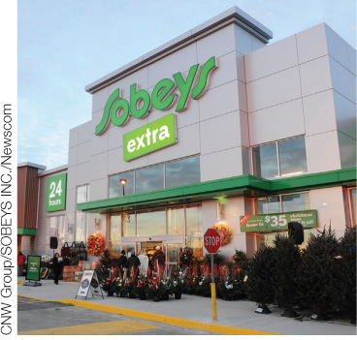
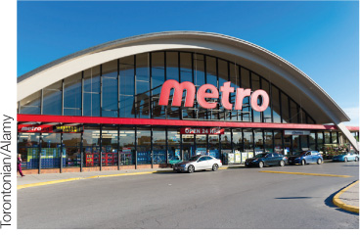
Organizational Boundaries and Environments
(LO 2-1)
External Environment
  factors beyond an organization's boundaries that cannot be controlled
    (i.e. competition)
Organizational Boundaries
  that which separates the organization from its environment
Notes:
Learning Objective 2-1
Page(s): 25-26

Slide 7
Dimensions of the External Environment
(LO 2-1)
Multiple Organizational Environments
Economic environment
Technological environment
Political-legal environment
Socio-cultural environment
Business environment
Global environment
Emerging challenges and opportunities
Notes:
Learning Objective 2-1
Page(s): 26-27
Figure 2.1
Notes
Emerging challenges and opportunities include: Outsourcing, The Growing Role of Social Media, Business Process Management

Slide 8
The Economic Environment
(LO 2-2)
The conditions of the economic system in which an organization operates
Economic Stability
Economic Growth
Full Employment
Key Economic Goals
Notes:
Learning Objective 2-2
Page(s): 26-31

Slide 9
The Economic Environment
(LO 2-2)
  Economic Growth Overview
The Business Cycle
Aggregate Output and the Standard of Living
Gross Domestic Product (GDP) and
Gross National Product (GNP)
Productivity
Balance of Trade
National Debt
Notes:
Learning Objective 2-2
Page(s): 27-30

Slide 10
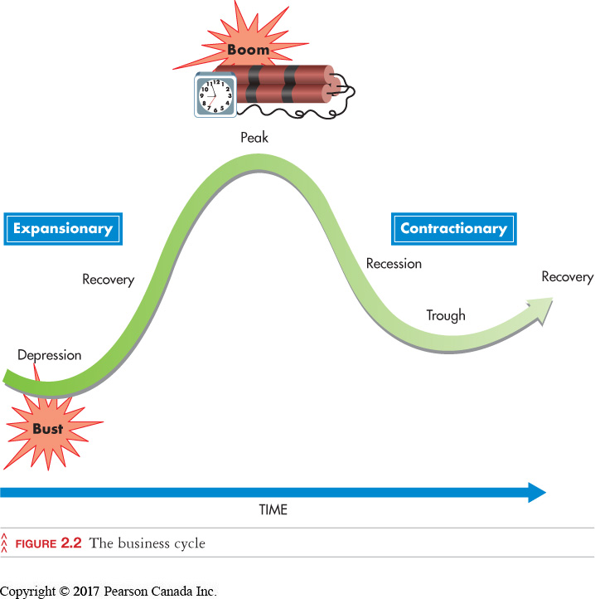
The Economic Environment
(LO 2-2)
Business Cycle
  the typical pattern of short-term ups and downs in an economy (peak, recession, trough and recovery)
Notes:
Learning Objective 2-2
Page(s): 28
Figure 2.2

Slide 11
The Economic Environment
(LO 2-2)
Aggregate Output
  measure of economic growth
  total quantity of goods and services produced by an economic system during a given period
Standard of Living
  total quantity and quality of goods and services that a country’s citizens can purchase with their currency
Productivity
  measure of growth that compares the output of an economic system with the resources that are needed to produce the output
  standard of living improves through increases in productivity
Notes:
Learning Objective 2-2
Page(s): 27-29

Slide 12
The Economic Environment
(LO 2-2)
  Measuring Economic Growth
  Gross National Product (GNP)
    value of all goods and services produced by a national economy within a given period regardless of production location
  Gross Domestic Product (GDP)
    value of all goods and services produced by a national economy within a given period with domestic factors of production
Real Growth Rates
GDP Per Capita
Real GDP
Notes:
Learning Objective 2-2
Page(s): 28-29

Slide 13
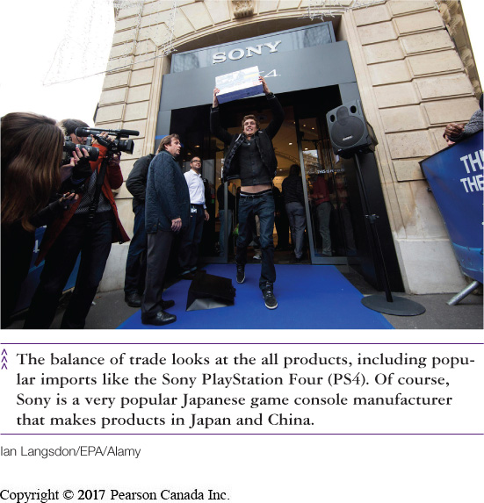
The Economic Environment
(LO 2-2)
Balance of Trade
  value of all exported products minus imported products
National Debt
  amount of money that a government owes its creditors
  increases/decreases based on the budget deficit/surplus
Exports
Imports
Notes:
Learning Objective 2-2
Page(s): 29
Notes
Positive balance of trade: more exports = economic growth
Lower debt: more $ for private investment

Slide 14
The Economic Environment
(LO 2-2)
Economic Stability
  condition when the amount of money available and the quantity of goods and services produced are growing at about the same rate
Deflation
Inflation
Unemployment
Threats to economic stability
Notes:
Learning Objective 2-2
Page(s): 30-31

Slide 15
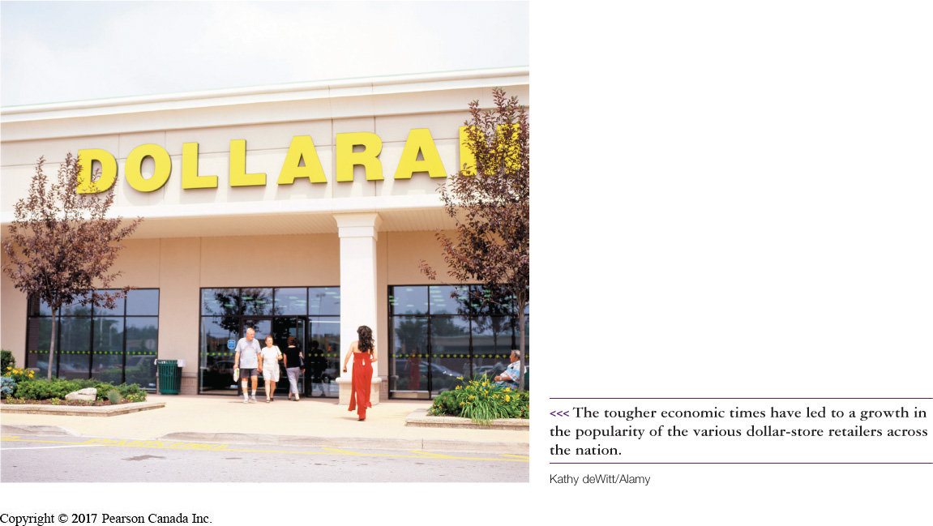
The Economic Environment
(LO 2-2)
Inflation
  occurs when there is widespread price increases in an economic system
Consumer Price Index (CPI)
  tool used to measure inflation
Deflation
  a period of generally falling prices
Notes:
Learning Objective: 2-2
Page(s): 30
Figure 2.3

Slide 16
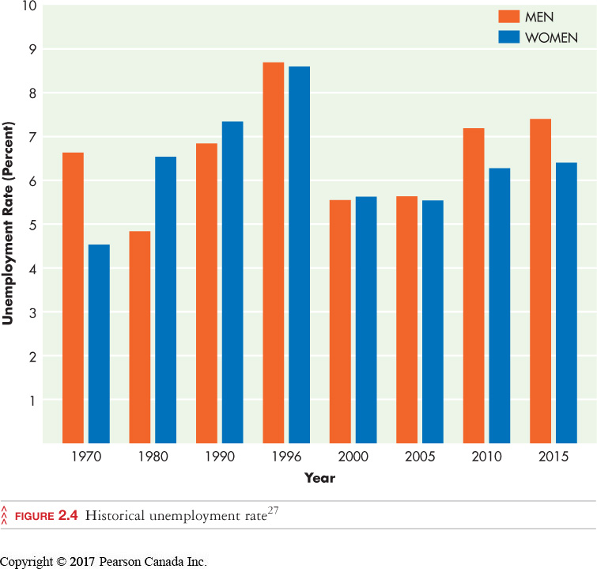
The Economic Environment
(LO 2-2)
Unemployment
  level of joblessness among people actively seeking work in an economic system
Seasonal
Cyclical
Frictional
Structural
Types of Unemployment
Notes:
Learning Objective 2-2
Page(s): 31
Figure 2.4
Notes
When unemployment is low, there is a labour shortage which raises wages and prices.
When wage rates are too high, workers are laid off, sales drop, more layoffs, etc.
If demand stays high and prices go up, inflation sets in.

Slide 17
The Economic Environment
(LO 2-2)
Managing the Canadian Economy
Fiscal Policies
Monetary Policies
Stabilization policies
Notes:
Learning Objective 2-2
Page(s): 31
Notes
High interest rates = tight monetary policy
Low interest rates = easy monetary policy
Stabilization Policies: fiscal and monetary policies used to stabilize prices and to smooth out fluctuations in output and unemployment
Fiscal policies: determine how the government collects and spends its revenues
Monetary policies: determine the size of a nation’s monetary supply

Slide 18
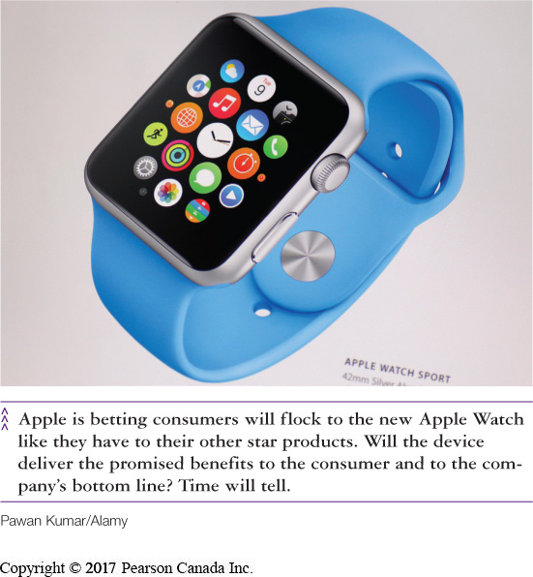
The Technological Environment
(LO 2-3)
Technology
  all the ways a company creates value for its customers
    knowledge, work methods, physical equipment, etc.
Notes:
Learning Objective 2-3
Page(s): 31-33

Slide 19
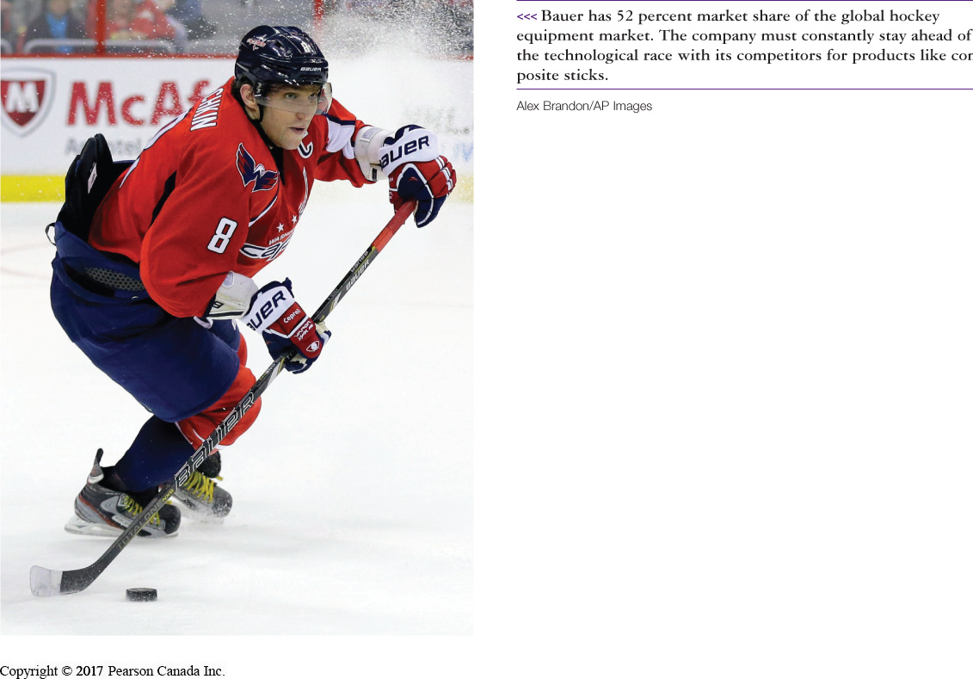
The Technological Environment
(LO 2-3)
Research & Development (R&D)
  provides new ideas for products services and processes
    basic
    applied
Bauer constantly innovates and spends heavily on R&D
Notes:
Learning Objective 2-3
Page(s): 31-32

Slide 20
The Political-Legal Environment
(LO 2-4)
Reflects the relationship between business and government (e.g., regulations)
  pro- or anti-business sentiment
  political stability
  international relations
Notes:
Learning Objective: 2-4
Page(s): 33
Notes
Political stability is necessary when doing business internationally or even between provinces. If relations between countries is poor, there is less likelihood of trade between these two countries

Slide 21
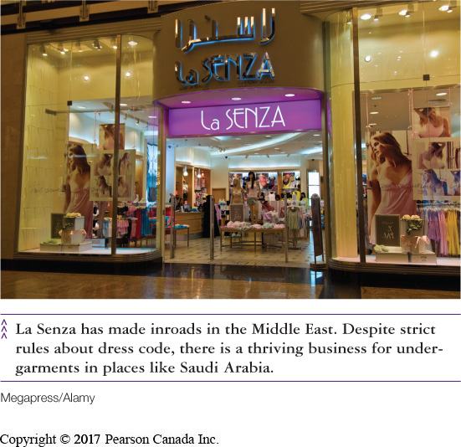
The Socio-Cultural Environment
(LO 2-5)
Customs, values, attitudes and demographic characteristics of the society in which an organization functions
Customer preferences and tastes
  vary across and within national
  boundaries
Ethical compliance and responsible business behaviour
Notes:
Learning Objective 2-5
Page(s): 34
Notes
In today’s changing environment, it is often difficult to accurately track and understand a business’ competitive health. Stakeholders have a right to know how a company is performing in order to make competent and informed decisions.

Slide 22
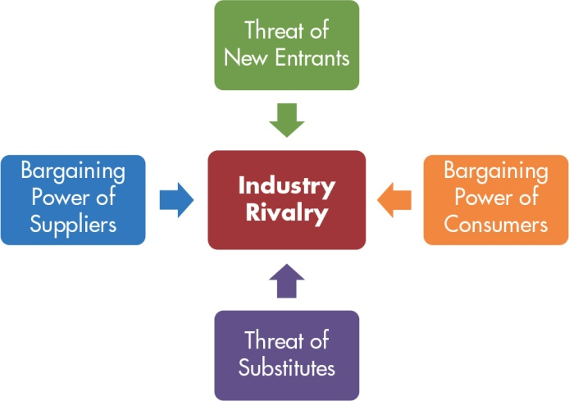
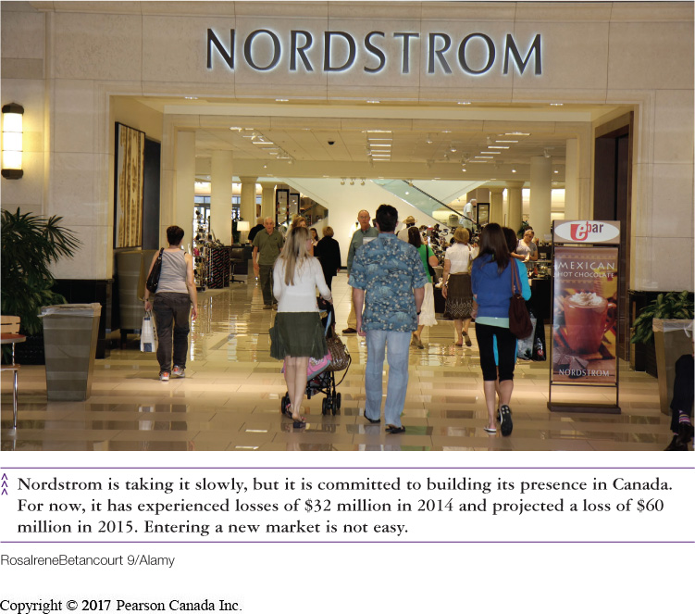
The Business Environment
(LO 2-6)
The Industry Environment
  Porter’s five forces model is used to analyze the competitive situation in an industry.
Notes:
Learning Objective 2-6
Page(s): 36
Figure 2.5

Slide 23
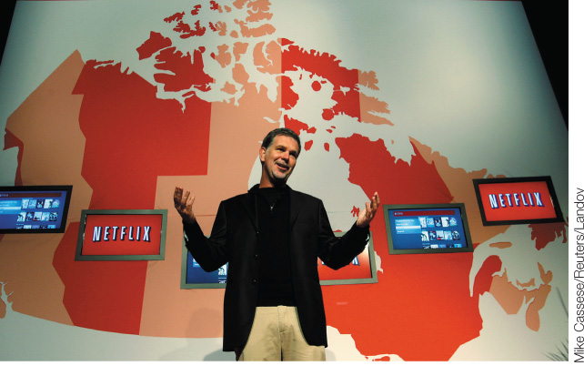
The Business Environment
(LO 2-6)
Emerging Challenges and Opportunities in the Business Environment
The most successful firms are getting leaner by focusing on their core competencies
  the skills and resources with which an organization competes best and creates the most value for owners
Notes:
Learning Objective 2-6
Page(s): 36-38

Slide 24
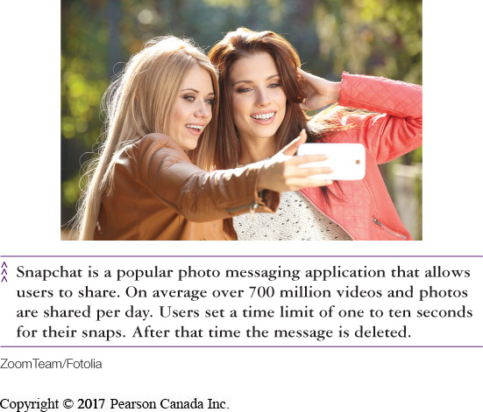
The Business Environment
(LO 2-6)
Outsourcing
  paying suppliers and distributors to perform certain business processes
The Growing Role of Social Media
  social media is now an integral part of daily communication (especially among Millennials)
Business Process Management
  moving away from department-oriented organizations toward process-oriented teams
Notes:
Learning Objective 2-6
Page(s): 37

Slide 25
Redrawing Corporate Boundaries
(LO 2-7)
Acquisitions and Mergers
  horizontal, vertical or conglomerate mergers
  friendly or hostile takeovers
Divestitures and Spinoffs
  selling part of existing business or setting it up as a new corporation
Notes:
Learning Objective 2-7
Page(s): 39

Slide 26
Redrawing Corporate Boundaries
(LO 2-7)
Friendly Takeover
  the acquired company welcomes the acquisition, (needs cash or other benefits)
Hostile Takeover
  the acquiring company buys enough of the other company’s stock to take control
    a poison pill is a defense tactic that management can adopt to make a firm less attractive
Poison Pill
Notes:
Learning Objective: 2-7
Page(s): 39

Slide 27
Redrawing Corporate Boundaries
(LO 2-7)
Employee-Owned Corporations
  employee stock ownership programs (ESOP)
Strategic Alliances
  two or more companies temporarily join forces
  often called a joint venture
Notes:
Learning Objective: 2-7
Page(s): 39

Slide 28
Redrawing Corporate Boundaries
(LO 2-7)
Subsidiary and Parent Corporations
  subsidiary corporation owned by another corporation
  parent corporations own subsidiary corporations
Parent Company
Subsidiary Company
Notes:
Learning Objective: 2-7
Page(s): 39

Slide 29
QUICK-CHECK QUESTIONS
1) Environmental protection laws, interest rates, societal values, and the emergence of new technologies can significantly impact the profitability of a firm. These types of issues can not be controlled by a business as they are considered to exist in the ________.
A) external environment
B) internal environment
C) organization’s boundaries
D) global context
Answer:
A) external environment

Slide 30
QUICK-CHECK QUESTIONS
2) The total amount of money that a country owes its creditors.
A) National Deficit
B) Purchasing Power Parity Index
C) National Debt
D) Gross Domestic Product
Answer:
C) National Debt

Slide 31
QUICK-CHECK QUESTIONS
3) The federal government manages the Canadian economic system through two sets of policies: fiscal and monetary. Fiscal Policy refers to:
  A) the control of the money supply
  B) the control of interest rates
  C) the government’s approach to its spending and taxation
  D) the effective management and control of the national debt
Answer:
C) the government’s approach to its spending and taxation

Slide 32
QUICK-CHECK QUESTIONS
4) Simon would like to buy a Valentines gift for his girlfriend as a sign of his affection. To his disappointment he discovers that roses cost $75 a dozen. Luckily, he can buy chocolates for $20. According to Porter’s Five Forces Model, chocolates are a less costly _________.
  A) option
B) substitute
  C) replacement
  D) complement
Answer:
B) substitute

Slide 33
QUICK-CHECK QUESTIONS
5) An organization’s core competencies refers to:
  A) The company’s strategies to increase market share
  B) The company’s product offerings which achieve the highest profit levels
  C) The training programs used to increase employee productivity
  D) The skills and resources with which they compete best and create the most value for owners.
Answer: D) The skills and resources with which they compete best and create the most value for owners.

